Slide 1

Welcome to Valencia!
19th to 24th
SEP. 2022
"Flipped Classroom"
Paula García
paula.garcia@europass.it

Slide 2

About Me:
Watch my Powtoon: Teacher Intro

Slide 3
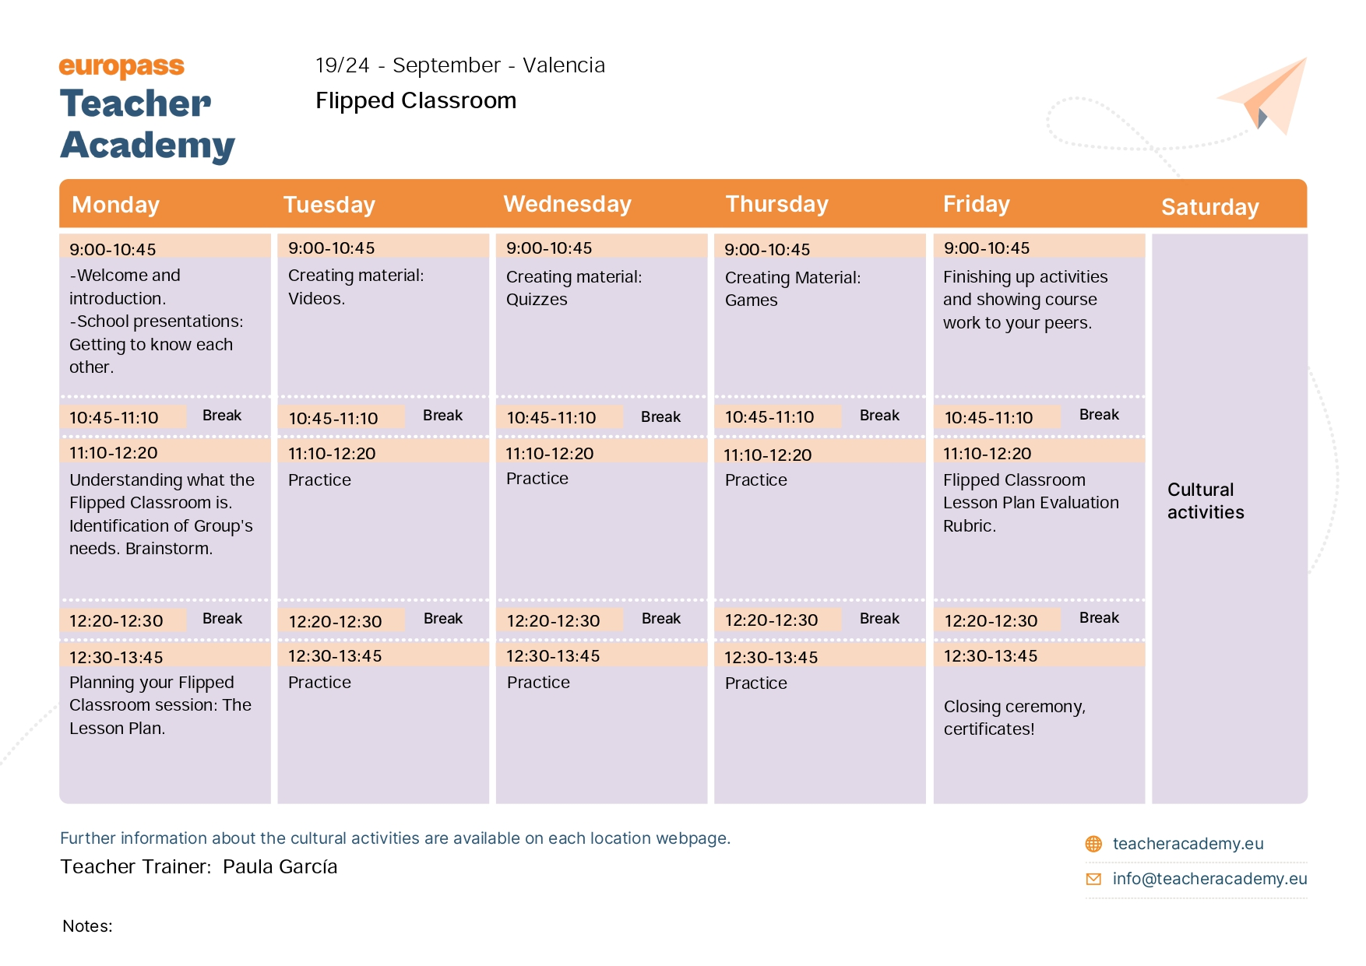
Timetable

Slide 4

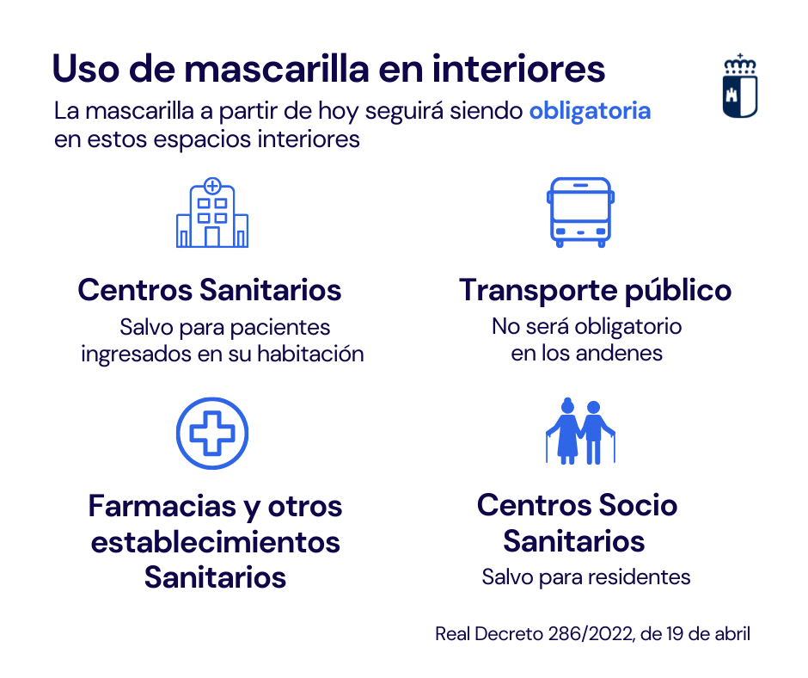
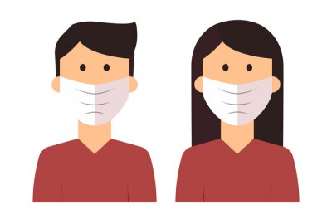
Wearing the MASK
Compulsory places
health centers
public transport
pharmacy
social health centers
https://www.avianca.com/hn/es/sobre-nosotros/centro-noticias/noticias-avianca/mascarilla-permitida-vuelos/
https://myloview.es/cuadro-coronavirus-persona-con-mascarilla-hombre-y-mujer-con-mascara-no-D0FFFF3
https://sanidad.castillalamancha.es/ciudadanos/enfermedades-infecciosas/coronavirus

Slide 5

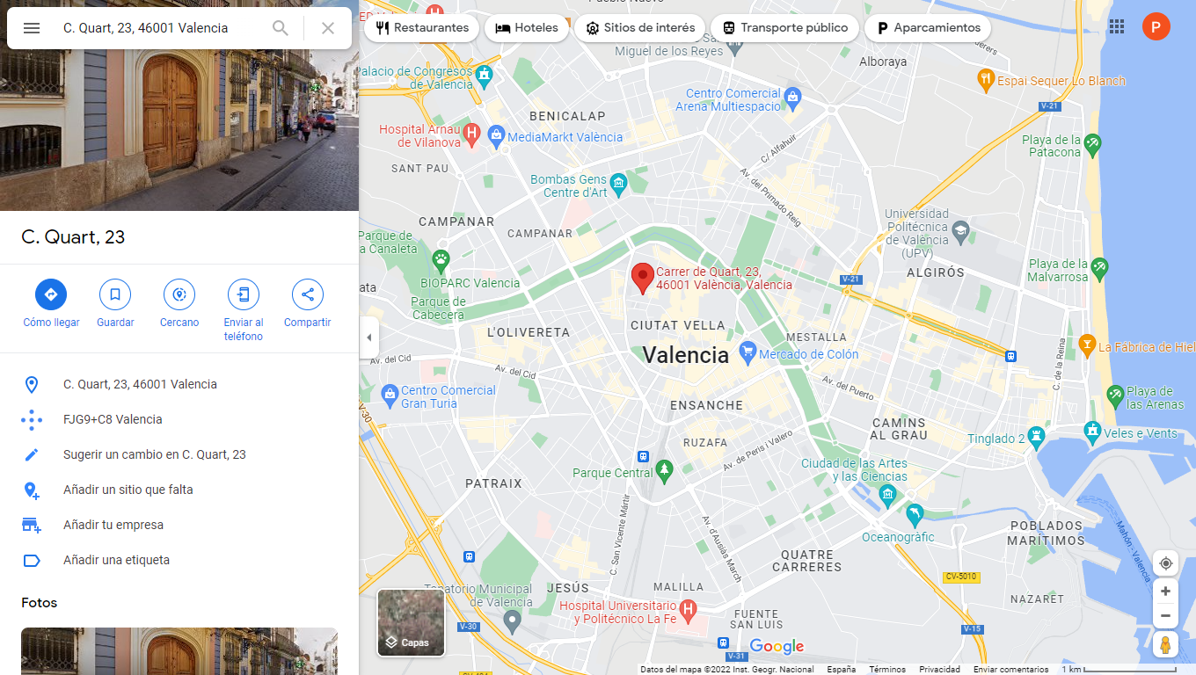
YOU ARE HERE
Do you need some tips??
<a href='https://www.freepik.es/fotos/mapa-ubicacion'>Foto de mapa de ubicacion creado por wayhomestudio - www.freepik.es</a>

Slide 6
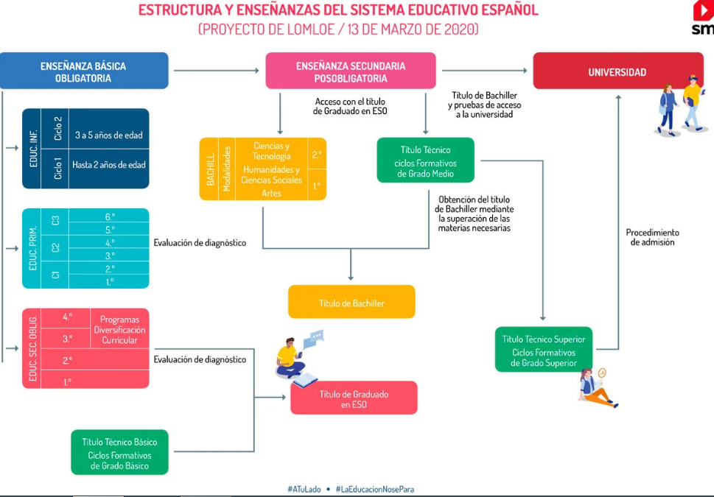
Spanish Education System

Slide 7
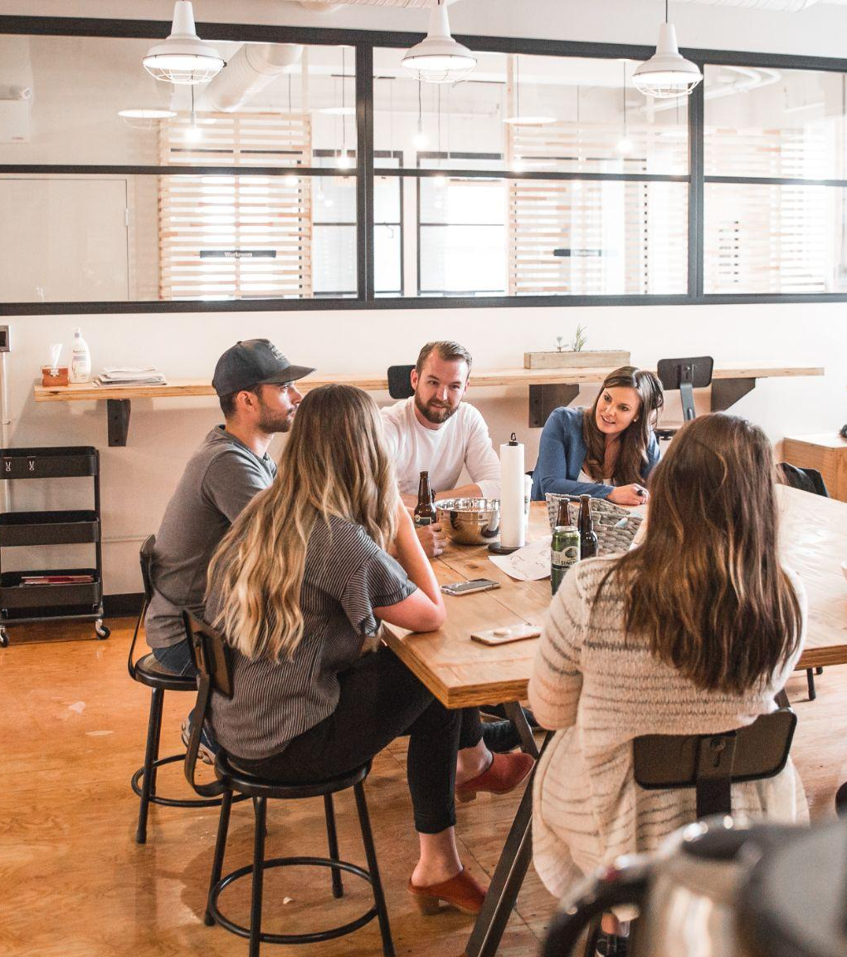
Let’s MEET US!
We would like to know more about you and your school
https://unsplash.com/es/fotos/PTRzqc_h1r4?utm_source=unsplash&utm_medium=referral&utm_content=creditShareLink

