Slide 1


Mobility Project
ERASMUS PLUS-KA1- STAFF
(2022, on the seven-year period 2021-2027)

Slide 2
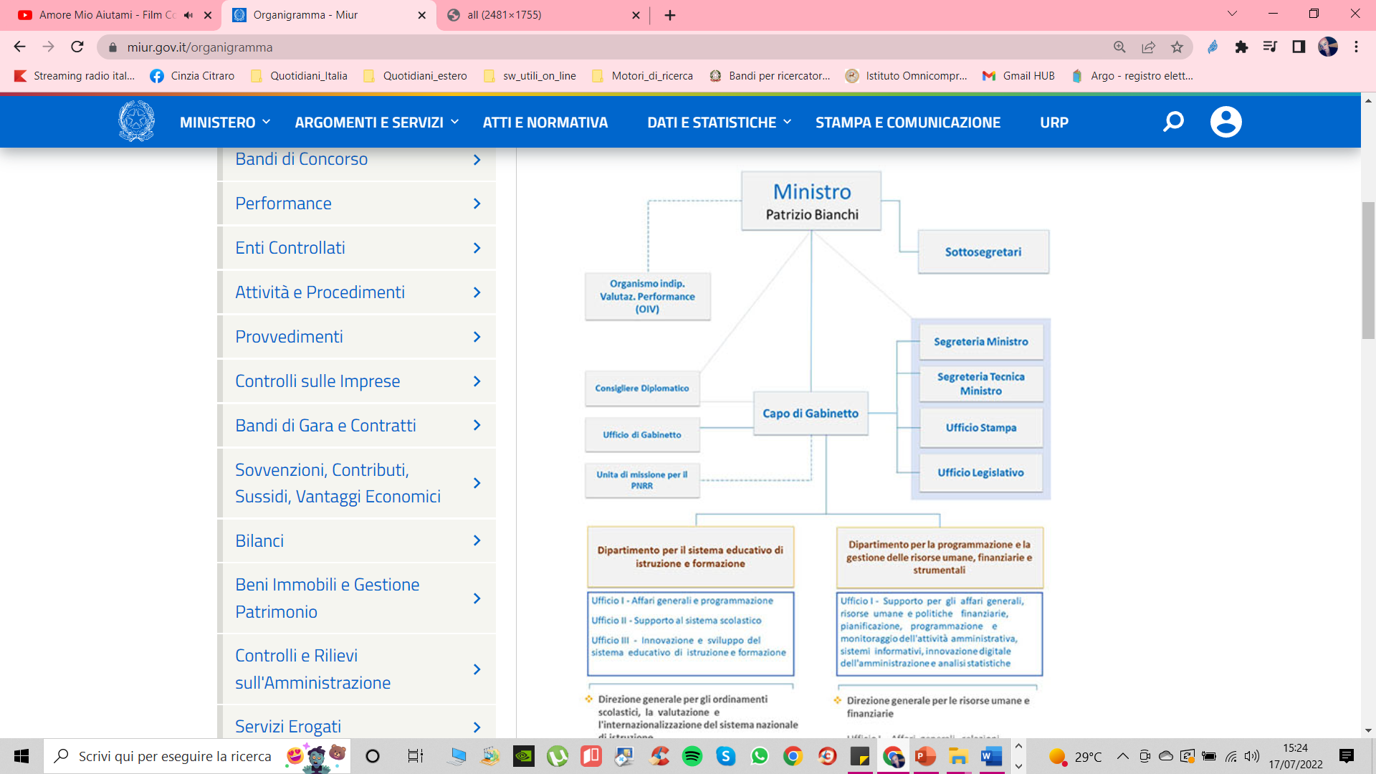
Italian Education System:
The structure of the
Ministry of education,
University and research
http://www.miur.it

Slide 3
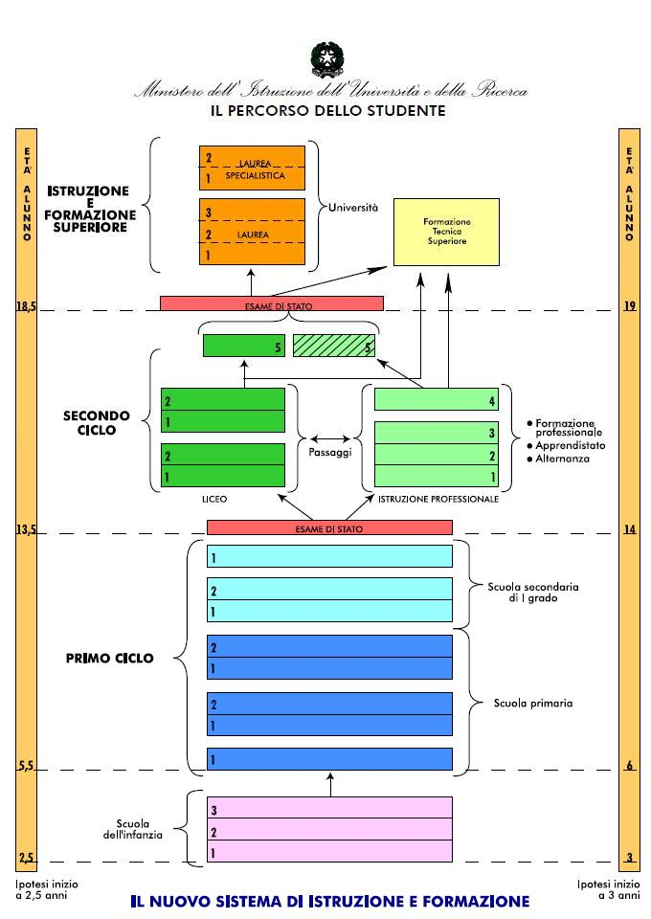
Italian Education System:
Course of Study

Slide 4


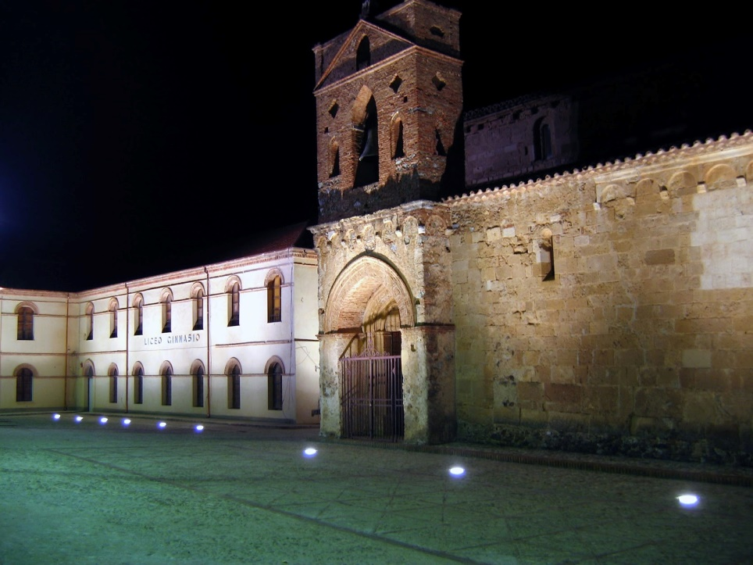
ISTITUTO OMNICOMPRENSIVO STATALE SAN DEMETRIO CORONE (CS)
Shkolla e Bashkuar Shën Mitër Koronë (CS)
http://www.iosandemetrio.edu.it/

Slide 5

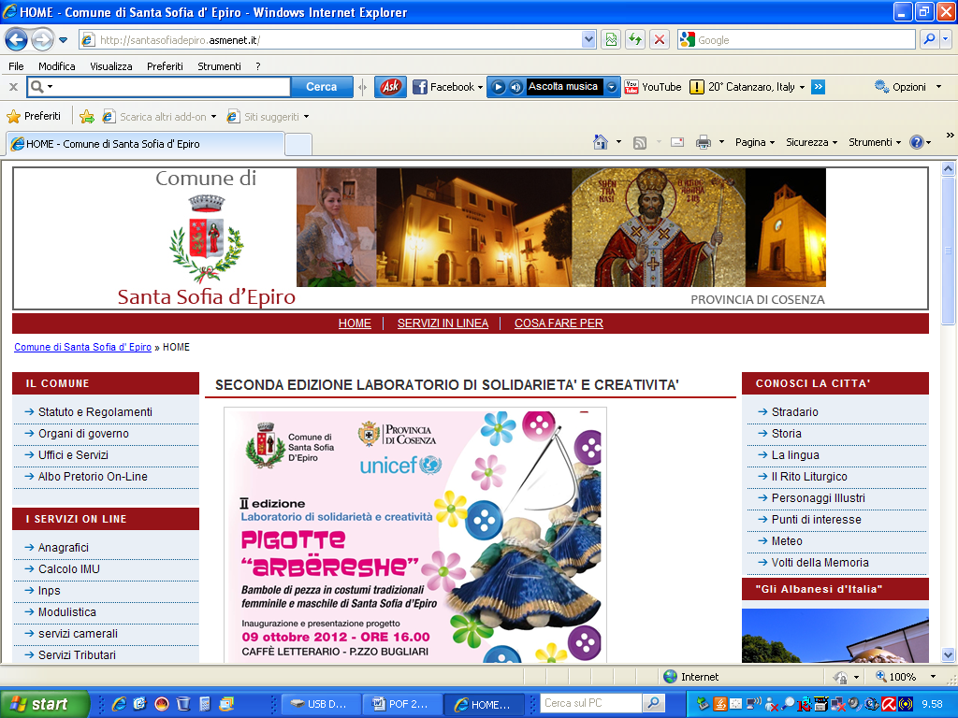

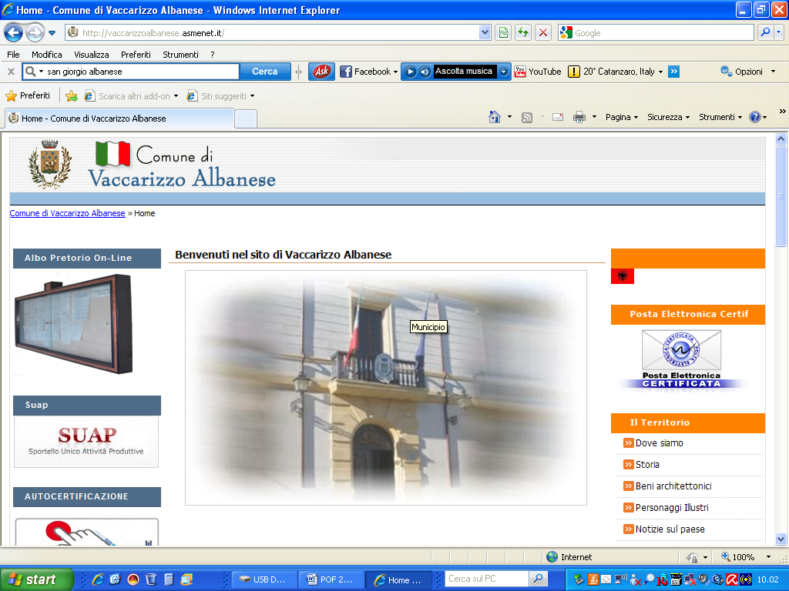
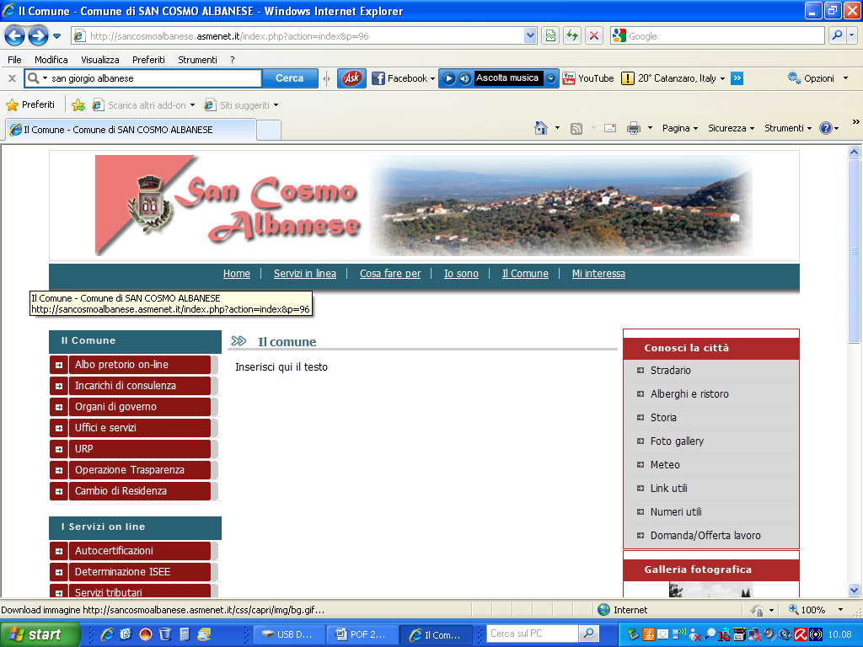
The State All-Inclusive Institute of San Demetrio Corone was created on 1 September 2009 following the sizing plan (law 233/97), and, starting from the 2012/2013 school year, it also includes the schools of the Municipalities of Santa Sofia d'Epiro, San Giorgio Albanese, Vaccarizzo Albanese and San Cosmo Albanese. The origins of this Italian-Albanian centre (arbëresh) date back to the second half of the 15th century, when large groups of refugees, forced to leave Albania, Epirus and some areas of the Peloponnese in Greece, poured into Puglia and Calabria seeking asylum and support.The abandonment of these lands became a sad necessity, given the continuous Turkish attacks, which could no longer be contained after the death of the Albanian hero Giorgio Castriota Skanderbeg in 1468.
San Demetrio Corone
Santa Sofia d’Epiro
San Giorgio Albanese
Vaccarizzo Albanese
San Cosmo Albanese

Slide 6
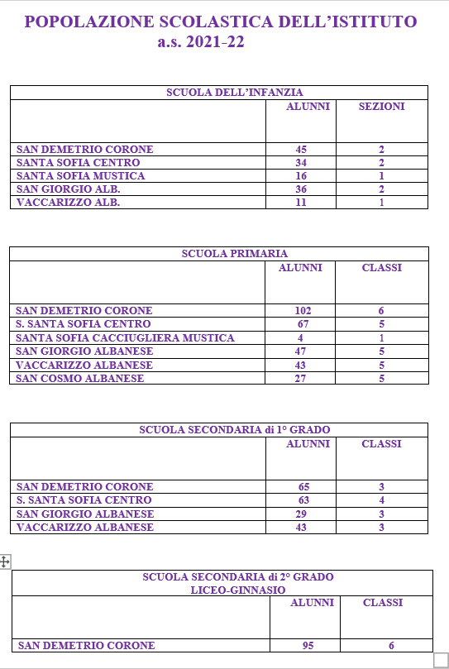
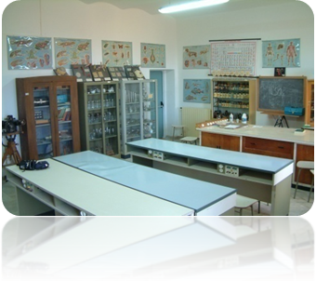
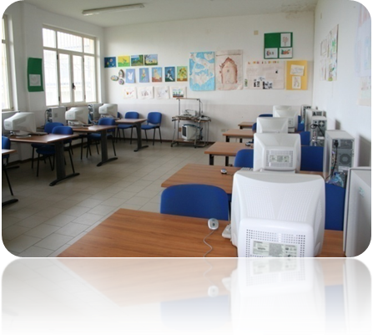
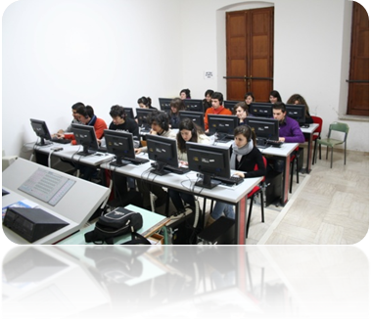
The All-inclusive State Institute of San Demetrio Corone
comprehends:
Kindergarten (5 complexes);
Primary School (6 complexes);
Lower Secondary School (4 complexes);
Second Level Secondary School (Liceo San Demetrio Corone).

Slide 7
The State All-Inclusive Institute of San Demetrio Corone has among its strategic objectives that of promoting the European dimension of learning.
Our Institute is therefore committed to collaborating in building a Europe of education and training through the following objectives:
1. TO PROMOTE AN ACTIVE EUROPEAN CITIZENSHIP open and respectful of Diversity in all their aspects, starting from the cultural characteristics, albeit in the common basis of European values ​​and opportunities, in which to ascribe the Erasmus + Project.
2. TO USE THE EUROPEAN TOOLS FOR THE IMPROVEMENT OF SKILLS AND STRENGTHENING THE QUALITY OF TEACHING AND LEARNING with the Promotion of the Mobility Activities Abroad of Teachers and Students.

Slide 8

IO SAN DEMETRIO CORONE
Gruppo Etwinning «A Vision to the world»
Amsterdam: 21st Century Skills for Teachers and Students
Berlino: Explaining the European Union and its opportunities to your students
Valencia: Flipped Classroom
Massimo Celiberto
Cinzia Citraro
Giovanni Andrea Gallo
Patrizia Lazzarini
Giuseppe Liguori
Angelo Pagliaro
Maurizio Scaramuzzo
Antonio Sena
Fenisia Serembe
Concetta Smeriglio
Teresa Johna Taranto
Teresa Anna Zaccaro
IO SAN DEMETRIO CORONE Gruppo Etwinning
Amsterdam: 21st Century Skills for Teachers and Students
Cinzia Citraro
Giuseppe Liguori
Angelo Pagliaro
Antonio Sena
Fenisia Serembe
https://groups.etwinning.net/221285/home

Slide 9
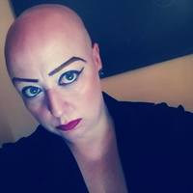
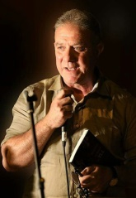
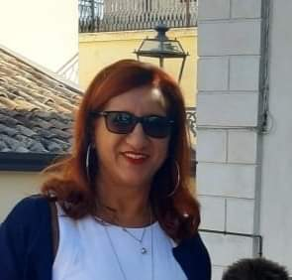
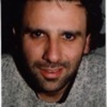
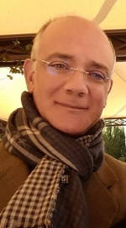
Who we are?
Cinzia Citraro teaches
Classical in
Classical High School
Giuseppe Liguori teaches
Albanian language in
Classical
High School
Fenisia Serembe teaches on common place in Primary School
Antonio Sena teaches English language in
Classical
High School
Angelo Pagliaro teaches
Physical Education in
Classical
High School

Slide 10


Thanks for your kind attention!
http://www.iosandemetrio.edu.it/
cinziacitraro@iosandemetrio.edu.it
giuseppeliguori@iosandemetrio.edu.it
angelopagliaro@iosandemetrio.edu.it
antoniosena@iosandemetrio.edu.it
fenisiaserembe@iosandemetrio.edu.it

