Slide 2

Presentation of Nørresundby Gymnasium og HF
21st Century Skills for Teachers and Students
Who are we?
What is Nørresundby Gymnasium og HF?
Who are our students?
What do we do?
What are our goals?

Slide 3
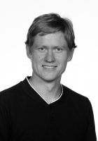
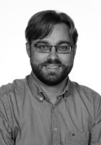
Presentation of Nørresundby Gymnasium og HF
21st Century Skills for Teachers and Students
Who are we?
What is Nørresundby Gymnasium og HF?
Who are our students?
What do we do?
What are our goals?
Christian Simonsen Fisker Morten Vinther
MSc., Phd. MSc.
Physics and Matematics Physics and Matematics
2008 - 2007 -

Slide 4
Presentation of Nørresundby Gymnasium og HF
21st Century Skills for Teachers and Students
Who are we?
What is Nørresundby Gymnasium og HF?
Who are our students?
What do we do?
What are our goals?

Slide 5
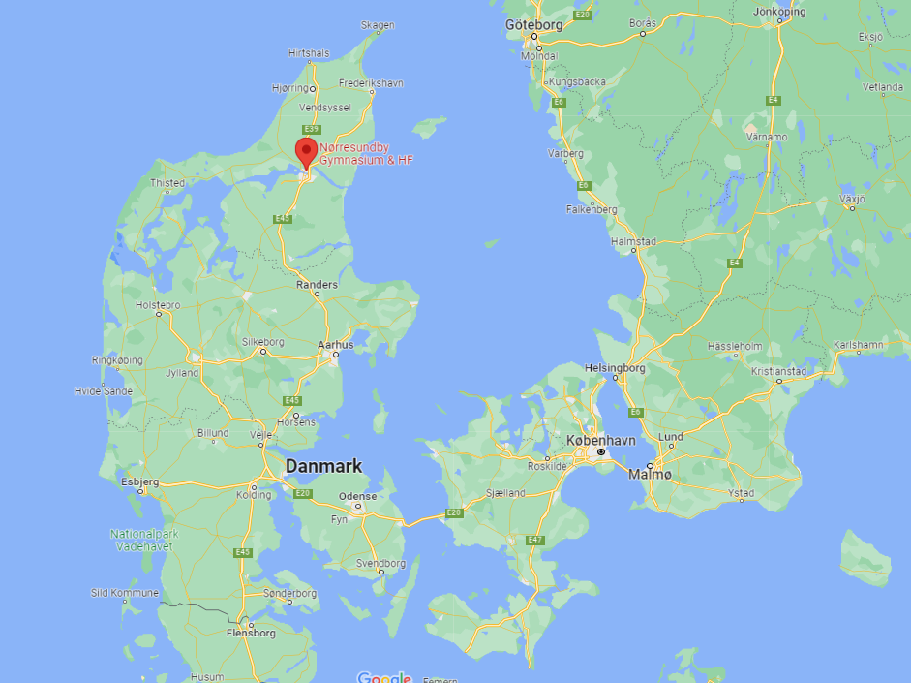
Presentation of Nørresundby Gymnasium og HF
21st Century Skills for Teachers and Students
Who are we?
What is Nørresundby Gymnasium og HF?
Who are our students?
What do we do?
What are our goals?

Slide 6
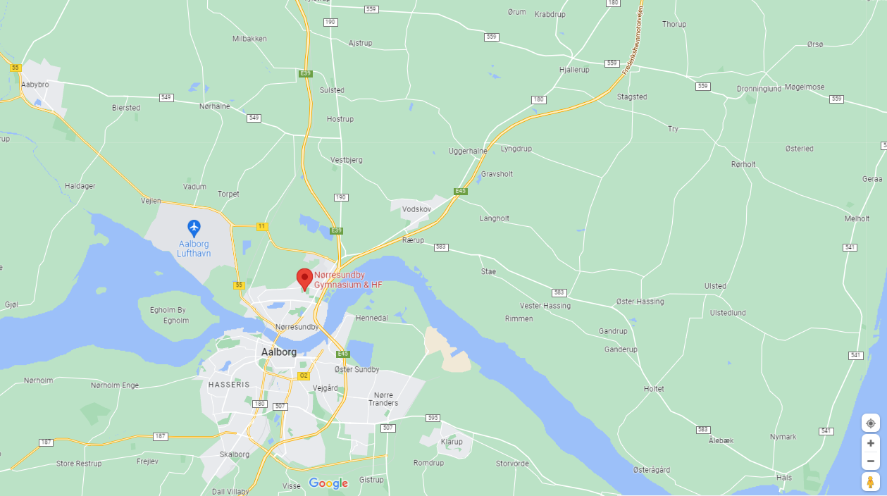
Presentation of Nørresundby Gymnasium og HF
21st Century Skills for Teachers and Students
Who are we?
What is Nørresundby Gymnasium og HF?
Who are our students?
What do we do?
What are our goals?

Slide 7
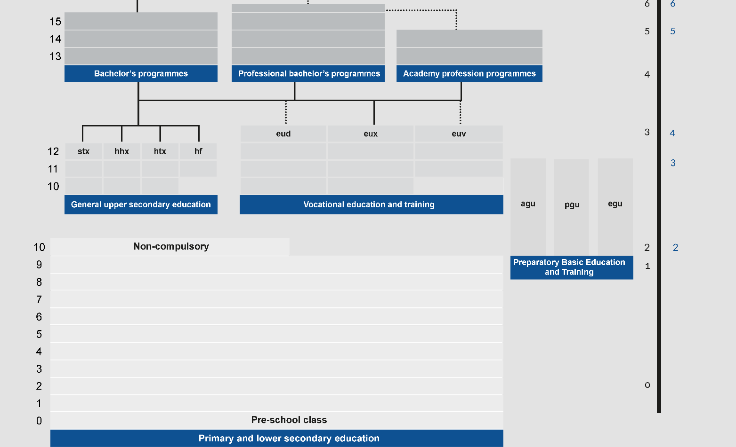
Presentation of Nørresundby Gymnasium og HF
21st Century Skills for Teachers and Students
Who are we?
What is Nørresundby Gymnasium og HF?
Who are our students?
What do we do?
What are our goals?
Source: https://ufm.dk/en/education/the-danish-education-system/overview/danish_education_system

Slide 8
Presentation of Nørresundby Gymnasium og HF
21st Century Skills for Teachers and Students
Who are we?
What is Nørresundby Gymnasium og HF?
Who are our students?
What do we do?
What are our goals?
STX – Higher General Examination Programme – 550 students
3 months foundation course | 2 years and 9 months specialized study programme
Danish, english, social science, physical Education Basic course in general knowledge of languages Basic course in natural sciences Preparation for choice of specialization | Danish, english, 2nd language (french, german or spanish), history, physics, artistic subject, mathematics, religion, social science, chemistry, biology, natural geography, physical Education Specialization in 2 – 3 courses Elective courses (psychology, astronomy…)

Slide 9
Presentation of Nørresundby Gymnasium og HF
21st Century Skills for Teachers and Students
Who are we?
What is Nørresundby Gymnasium og HF?
Who are our students?
What do we do?
What are our goals?
HF – Higher Preparatory Examination Programme – 200 students
2 years | Profession orientation
Danish, english, mathematics Natural Science Group (chemistry, biology and geography) Humanities and Social Science Group (history, social science and religion) Physical education or an artistic subject Elective courses | A set of subjects oriented to a profession (mathematics and business economics, psychologi and philosophy, biology and physical education, mathematics and innovation) Three trainee courses aimed at supporting the students choice of profession

Slide 10
Presentation of Nørresundby Gymnasium og HF
21st Century Skills for Teachers and Students
Who are we?
What is Nørresundby Gymnasium og HF?
Who are our students?
What do we do?
What are our goals?

Slide 11
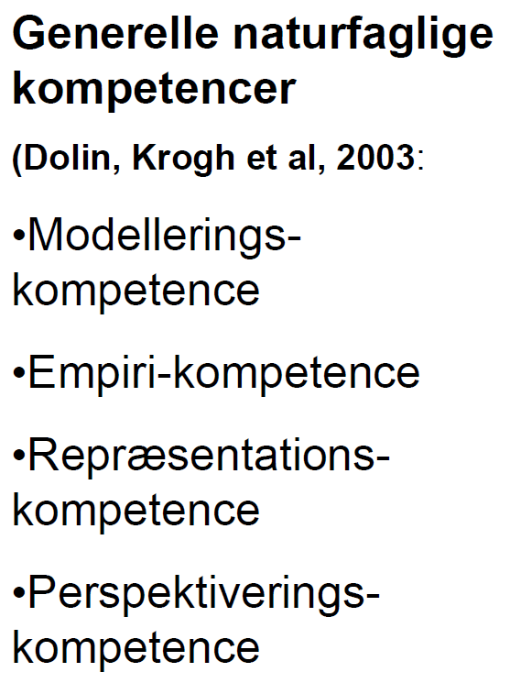
Presentation of Nørresundby Gymnasium og HF
21st Century Skills for Teachers and Students
Who are we?
What is Nørresundby Gymnasium og HF?
Who are our students?
What do we do?
What are our goals?
Problem based / inductive learning - Methods in physics:
Expressing the problem?
Design the experiment?
Analyze and interpret?
Three significant degrees of freedom

Slide 12
Presentation of Nørresundby Gymnasium og HF
21st Century Skills for Teachers and Students
Who are we?
What is Nørresundby Gymnasium og HF?
Who are our students?
What do we do?
What are our goals?
Inductive / deductive reflections on student responses
EKSPERIMENT SOM VERIFIKATION AF TEORI
Eleverne mangler motivation, og kan ikke relatere teorien til virkeligheden $⟶$ dårlig forståelse.
Elevernes motivation er lav, særligt blandt de svageste elever.
Dygtige elever kan som oftest sagtens håndtere situationen.
Alle elever er mere trygge ved situationen, fordi man ikke efter kort tid kastes ud i forsøg om noget helt nyt.
Sandsynligheden for at få brugbare resultater under forsøget er større jo mere eleverne ved om hvad de forventer.
EKSPERIMENT SOM MOTIVATION FOR TEORI
Situationen er mere utryg for eleverne fordi de i mindre grad fodres med viden af læreren.
Der er en stor risiko for, at eleverne ikke gør de observationer, læreren forventer.
De observationer eleverne gør, får de i højere grad en ejerfornemmelse over. Det er ikke blot noget de har læst i en bog.
Motivationen for at forstå og beskrive observationerne er formentligt større.

Slide 13
Presentation of Nørresundby Gymnasium og HF
21st Century Skills for Teachers and Students
Who are we?
What is Nørresundby Gymnasium og HF?
Who are our students?
What do we do?
What are our goals?
Challenges: The obstacles of working with cases/PBL
Challenge 1: Time
(not just our time to prepare)
Study theory -> do experiment -> conclude
Becomes
Study case -> analyze -> build (wrong) theory -> build experiment ->repeat -> generalize -> conclude
Iterations at different speeds with different outcomes in each group makes collective learning hard.
Challenge 2: Focus
When working on ”disproving conspiracy theories”, the average student only remembers the conspiracy theory (possibly as facts)
(weaker) Students will often forget the generalization and conclusion steps (maybe, because of abstraction), and only remember the case.
Exam situation challenges

Slide 14
Presentation of Nørresundby Gymnasium og HF
21st Century Skills for Teachers and Students
Who are we?
What is Nørresundby Gymnasium og HF?
Who are our students?
What do we do?
What are our goals?
Oral participation training and formative assessment
Presenting problems and theorems on a black board
Small groups and black board training
Discussing individual goals and progress with students
Clear session and course goals

Slide 15
Presentation of Nørresundby Gymnasium og HF
21st Century Skills for Teachers and Students
Who are we?
What is Nørresundby Gymnasium og HF?
Who are our students?
What do we do?
What are our goals?
The challenge of oral participation:
It has become too common that only 3-5 students in a class of 30 participate orally.
Our students today have a much higher self-awareness than 10 or 20 years ago.
75% of our students state that their willingness to participate in the classroom depends solely on the reaction of other students. (Not the teacher or the chance to practice, or obtain better grades)
Math: The tradition of students giving mathematical proofs in front of the class on the black board has died. We train in small groups instead.

Slide 16
Presentation of Nørresundby Gymnasium og HF
21st Century Skills for Teachers and Students
Who are we?
What is Nørresundby Gymnasium og HF?
Who are our students?
What do we do?
What are our goals?
The challenges of formative assessment:
The two hats: The formative approach promises a ”space for practice”, where there are ”no stupid questions”, and all attempts are valued. But still, the teacher has to grade the students regularly, which makes the students hesitant.
The false promise: Whenever I’m finding time to have a personal formative conversation with a student, I feel like I’m giving a promise og ”being seen” and ”helping with his/her personal challenges”, but in reality they are 30 students in the class which I teach 2-3 hours pr week. And I have maybe 80-140 students in all, so he/she will not often be remembered.
The wrong recipients: The ones most in need, are the ones least responsive.
The language barrier: ”This part was well done, but to improve…” often becomes just ”well done” in the ears of the listener. And the other way, ”I’m good at that” often means ”I saw you do it, so I assume I can as well”.

